Slide 1
Identifying hate speech from tweets using deep learning

Slide 2
Introduction
Hate Speech
Words or speech used to arouse hate or prejudice against a person or group(race, sex, religion)
Deep Learning
- Extension of Neural Networks

Slide 3
Past works
Aditya Gaydhani et al in Sep 2018 paper
‘Detecting Hate Speech and Offensive Language on Twitter using Machine Learning’
Used Logistic Regression, SVM and naives bayes
To detect hate speech in on Twitter
Achieved accuracy of 95.6%
Ziqi Zhang and Lei Luo in Oct 2018 paper:
Showed that hate speech are sparce in data
Discovered that hate speech lack unique discriminative feature

Slide 4
Objective
Use Deep Neural Network model to detect hate speech
Explore some NLP approaches in Text document
Answer research questions

Slide 5
CRISP - DM Method
Cross Industry Standard Process for Data Mining
Data Preparation
Data Understanding
Data Preprocessing
Data Analysis
Data Modeling
Evaluation

Slide 6
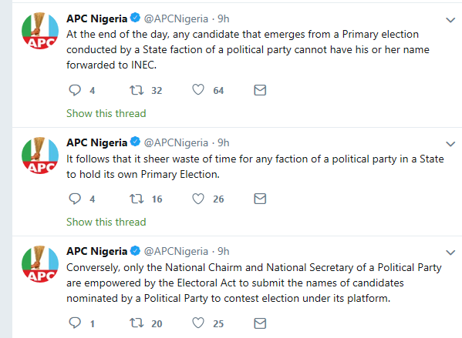
Data Preparation
Primary data
Extracted from Twitter
2019 Nigerian Presidential Election
#nigeriadecides #apc #inec
#pdp

Slide 7
Accessing Twitter Dev Interface
https://developer.twitter.com/
Log in with twitter username and password
Rest API
Streaming API

Slide 8
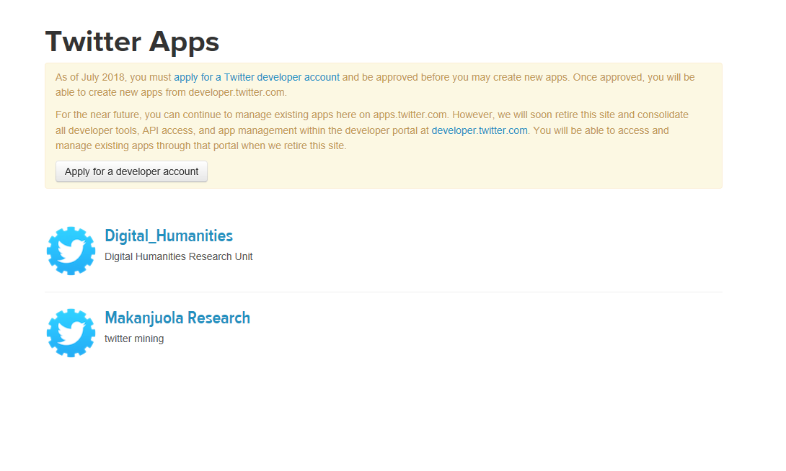

Slide 9
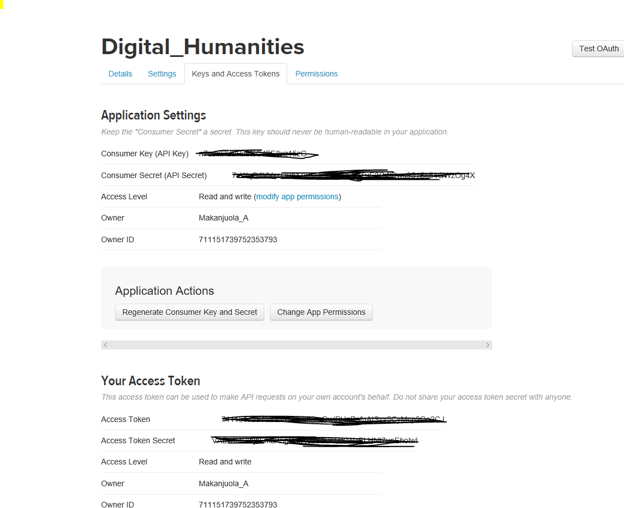

Slide 10
Data Understanding
Unstructured text data
From Twitter
Twitter data (quality data)
# of rows(Tweets): 4,217,909
Period : January 11, 2019 - February 25, 2019
# Word Tokens: 44 million

Slide 11
Data Preprocessing
Converted to lower
Removed emoticons
Removed hyperlinks
Removed stop words
Removed punctuations
Removed short words (words < 2)

Slide 12
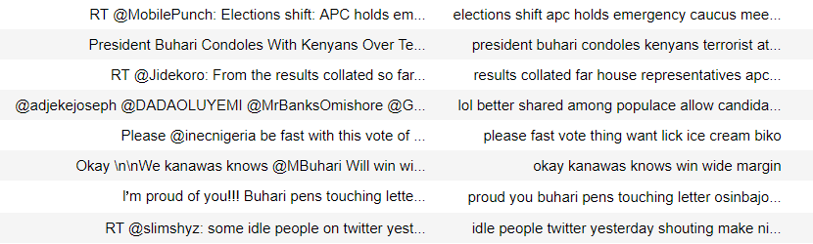
Raw tweet versus Cleaned tweet

Slide 13
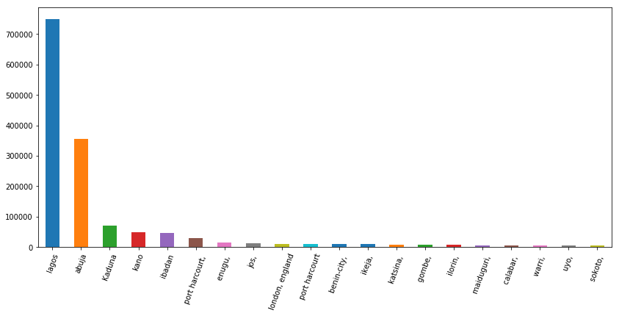
Top 20 Locations

Slide 14
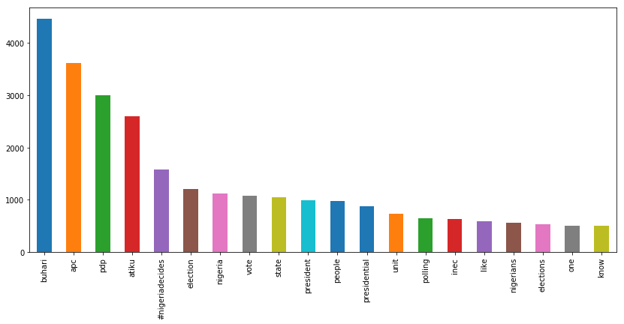
Top 20 Words

Slide 15
Corpus, N-gram and Word Clouds
What is a Corpus, Why Corpus?
N-gram
‘boy’ – no much meaning
‘Good boy’, ‘Handsome boy’ – Context and meaning added
Word cloud
Powerful tool for visualization Text Data
Words in a collection are enlarged or contracted based on Freq

Slide 16
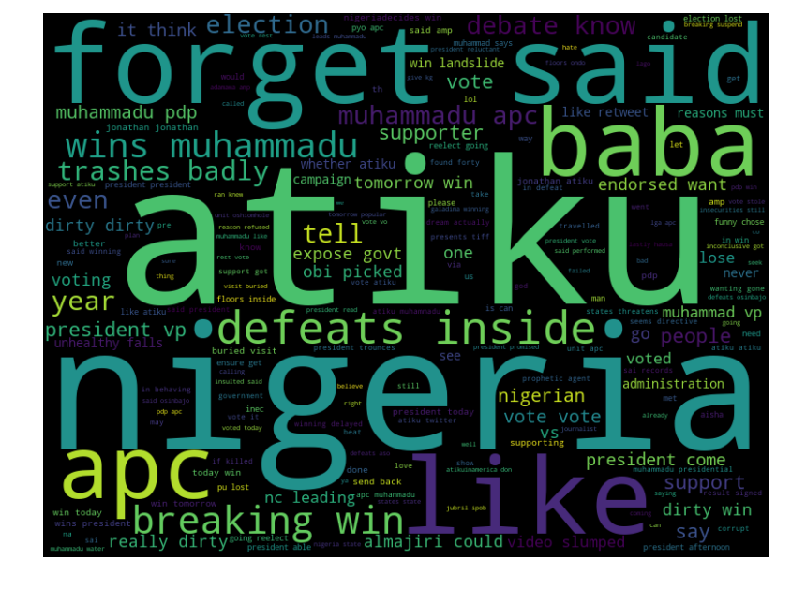
Word cloud of words around Mohammad Buhari

Slide 17
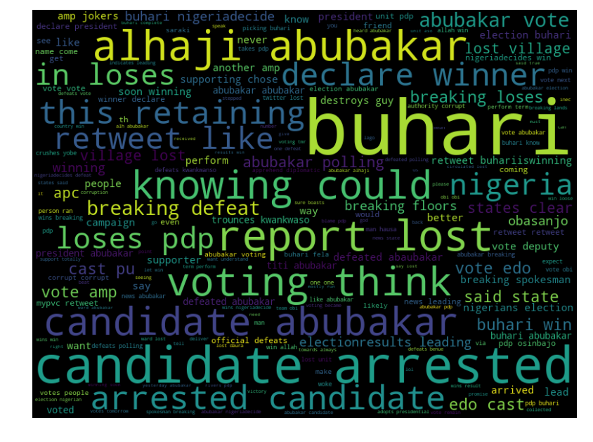
Word cloud of words around Atiku Abubakar

Slide 18
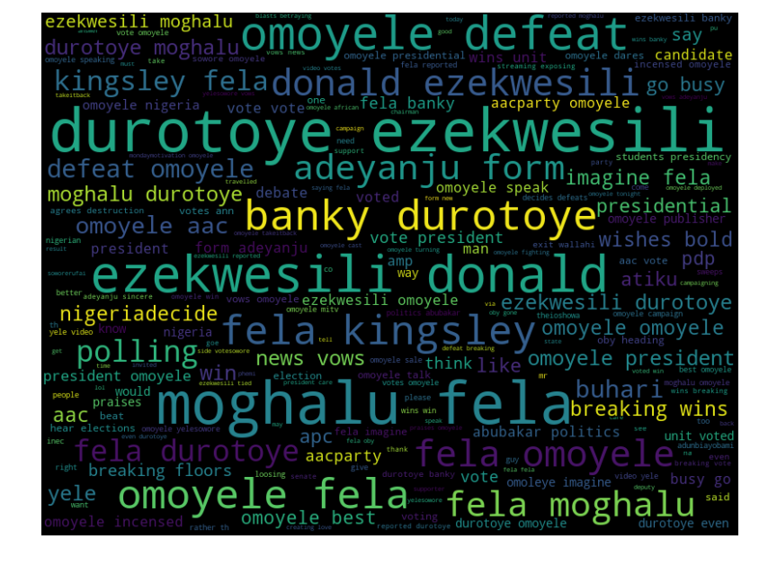
Word cloud of words around Omoyele Sowore

Slide 19
Data Preprocessing

Slide 20
Data Modeling
Two modeling approach
Machine Learning
Logistic Regression
Support Vector Machine
Decision Trees Classifier
Random Forest Classifier
Deep Learning

Slide 21
Machine Learning Modeling
Approach – Supervised Learning
Three further preprocessing needed
Split data into Training (80%) and Test (20%)
Target feature Labeling
Create Bag of Words (BOW) features

Slide 22
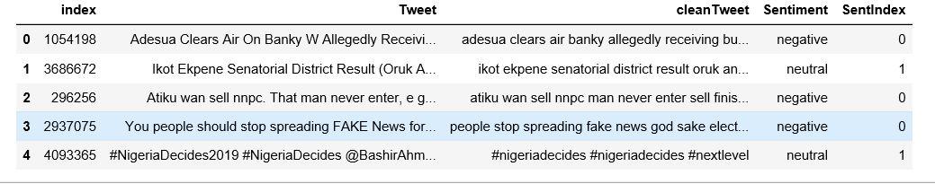
Target feature Labeling

Slide 23
Bag of Words(BOW)
Example
Tweet 1: adesua clears air banky allegedly receiving buhari
Tweet 2: even buhari spend yrs office never achieve obasanjo office
 | adesua | clears | air | banky | allegedly | receiving | buhari | even | spend | yrs | office | never | achieve | obasanjo | office
Tweet1 | 1 | 1 | 1 | 1 | 1 | 1 | 1 | 0 | 0 | 0 | 0 | 0 | 0 | 0 | 0
Tweet2 | 0 | 0 | 0 | 0 | 0 | 0 | 1 | 1 | 1 | 1 | 1 | 1 | 1 | 1 | 1

Slide 24

Logistic regression Model
Used in predicting Dichotomous Variables
Dependent variable is Log of Odds
Accuracy = 86%

Slide 25
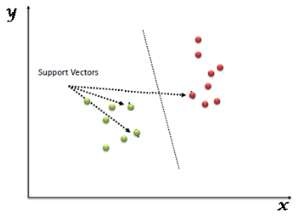
Support Vector Machine
Plot each data item as point in n-dimensional space
N = number of features
Then find hyper-plane that differentiates the classes
Accuracy = 86%

Slide 26
Decision Tree Classifier
Attempts to make decision by creating a tree of different classes
Node – test
Branch – outcome of test
Leaf – decision
Accuracy = 95%

Slide 27
Random Forest Classifiers
Multiple trees are grown
Each tree gives classification
Tree with most classification is chosen
Accuracy = 95%

Slide 28
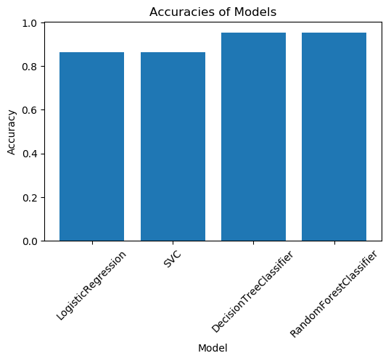
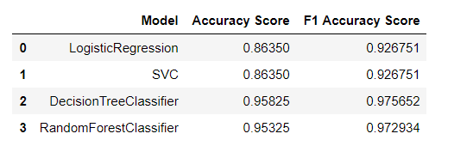
Model Comparison

Slide 29
Deep Learning Model
KERAS
high-level API used to build and train deep learning models
Used for fast prototyping,
advanced research,
and production

Slide 30
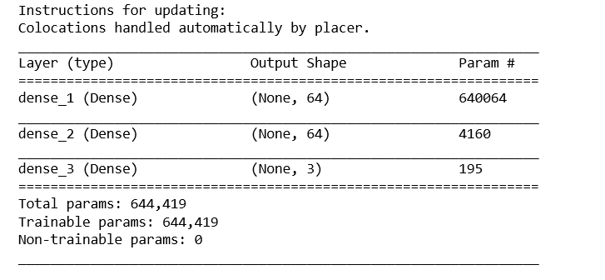
started with a model with 2 densely connected layers of 64 hidden elements.
The input_shape for the first layer equal to the number of words in dictionary.

Slide 31

Evaluating DL model performance (EPOCH)
In keras an epoch is an arbitrary cutoff
Used to separate training into distinct phases
Also for logging and periodic evaluation

Slide 32
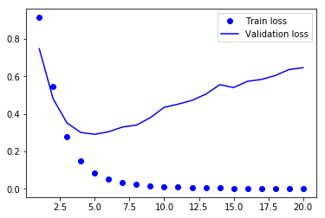
Training and Validation loss versus epochs

Slide 33

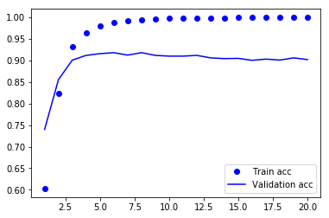
Training and Validation Accuracy versus epochs

Slide 34

Evaluation on test data.
Model trained on full training data
Tested performance of model on test data

Slide 35
Limitations
Labelling of target feature was done computationally
Sample of tweet was used for modelling (Volume tradeoff)

Slide 36
Future Works
Employ humans to label target feature to Improve model performance
Move data to cloud platforms(GCP or Amazon AWS) to increase robustness of model

Slide 37
Conclusion
Examined NLP possibilities
Compared ML models based on Accuracy and F1 score
Random Forest seems to be the best model
Examined capabilities of Deep Learning
Build DL models using Keras API in TensorFlow
Evaluated performance of DL Model on Test data

Slide 38
Works Cited
US, Custom, and Paper Masters. "Hate Speech In The US Research Papers". Papermasters.Com, 2019, https://www.papermasters.com/hate-speech-us.html.
"Deep Learning". En.Wikipedia.Org, 2019, https://en.wikipedia.org/wiki/Deep_learning.
"Deep Learning With Tensorflow". Edx, 2019, https://www.edx.org/course/deep-learning-with-tensorflow.
Badjatiya, Gupta, Shashank, Manish, Varma, and Vasudeva. "Deep Learning for Hate Speech Detection in Tweets." ArXiv.org. 01 June 2017. 10 Feb. 2019 <https://arxiv.org/abs/1706.00188>.

Slide 39
Acknowledgement
Professor Samuel Jator
Professor Matthew Jones
Dr. Nfi Ndikintum
Dr. Sumen Sen
Dr. Vajira Manathunga
Friends and Colleagues

Slide 40
Thank you

